Slide 1
Service Fabric Updates
@ryanmcintyre

Slide 2
The Things
Service Fabric Overview
Azure Container Host Comparison
Service Fabric Mesh

Slide 3








Azure Service Fabric: Microservices platform
Build and deploy microservices and containers on Windows and Linux, at any scale, on any cloud
</>
C++
Go
Programming Models
Dev & Ops Tooling
Orchestration
Lifecycle Management
Health & Monitoring
Always On Availability
Auto Scaling
Dev machine
Any cloud
On-premises
Azure

Slide 4



Service Fabric product offerings
Service Fabric Standalone
Azure Service Fabric
clusters
Azure Service Fabric
Mesh
Hardware
OS patching
Runtime upgrades
Cluster capacity planning Network and storage
Application deployment
You
Cluster capacity planning
Network and storage
Application deployment
Responsibility
Application deployment
Hardware
OS patching
Runtime upgrades
Billing
Hardware
OS patching
Runtime upgrades
Micro-billing
Cluster capacity planning
Network and storage
Azure

Slide 5













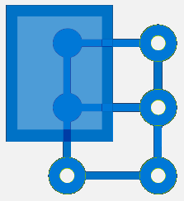

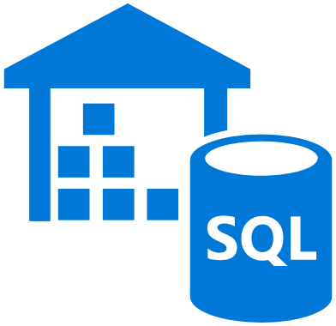
Service Fabric powers Azure and Microsoft
Productivity | Data/Storage | IoT/Messaging | Other/Azure | Developer
4.6 million Azure databases
2 Trillion messages a day
Office 365
SQL Database
Core Azure Services
Azure DevOps
Event Hub
Teams
Cosmos DB
100 Trillion requests / day
IoT Hub
Azure Container Registry
Azure Monitor
Dynamics 365
Azure Database for MySQL
Event Grid
13 Billion transactions per day
Azure Stack
Intune
Azure Database for PostgreSQL
Stream Analytics
Archive Storage
Skype for Business
Azure Database for MariaDB
Azure Sphere
PlayFab Multiplayer Services
Cortana
Digital Twins
Power BI
Azure Data Warehouse

Slide 6
























Working closely with ecosystem and Azure
 | Development | DevOps | Monitoring | Ingress/Network | Security
Take advantage of services and tools in the Service Fabric ecosystem
OR, Leverage extensive Azure integration
Octopus Deploy
VS Code
Dev Ops
Azure
Monitor
API Management
AAD
Visual
Studio
ARM
Log Analytics
Key Vault
IoT Hub
Azure Container Registry
SF Processor
https://aka.ms/ EventHubSFProcessor
Labs
Application
Insights
Event Hub

Slide 7















What applications can you build with Service Fabric?
Enterprise mission critical & multi-tenant
Applications such as B2B, API catalog and data-centric, low latency computation
IoT stream processing
Efficient data processing on millions of devices
Dev-ops intensive applications
Applications that require frequent updates
Machine learning and Artificial Intelligence
Predictive maintenance, personalization and running ML models
Interactive session and media
Applications requiring fast response times including media sharing, communication and gaming.

Slide 8
SF Latest (my) Highlights
6.5 (currently on hold(??))
Last release with VS tools for SF for VS 2015
Image Store Viewer in SF Explorer
SF Application DR Tool: https://github.com/Microsoft/Service-Fabric-AppDRTool
Win Server 2019 and 1809 Support (as of 6.4.654.9590)
POA open source: https://github.com/Microsoft/Service-Fabric-POA
AZ support

Slide 9



SF vs AKS vs ??

Slide 10
When to use Service Fabric
If you are currently using Service Fabric, keep using it
If you are a .NET based ISV
If you need the app models, Windows containers, stateful services, or to host guest executables

Slide 11
When to use ??
ACI
Single container
Burst
Dev
Functions
Event-driven
Serverless
App Service
App Migrations
N-Tier Apps (Web/Mobile/API)

Slide 12
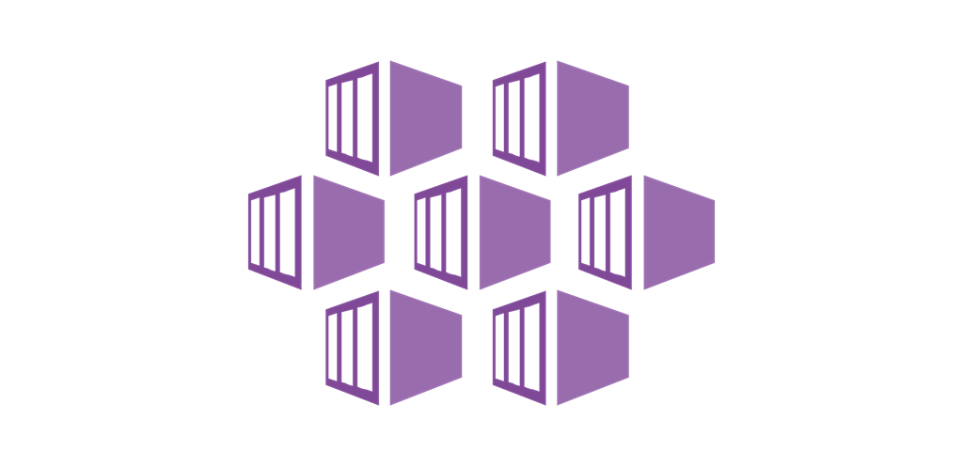
When to use AKS

Slide 13
SF Mesh

Slide 14
Service Fabric product offerings
Service Fabric Standalone
Azure Service Fabric
clusters
Azure Service Fabric
Mesh
Hardware
OS patching
Runtime upgrades
Billing
Cluster capacity planning Network and storage
Application deployment
You
Cluster capacity planning
Network and storage
Application deployment
Responsibility
Application deployment
Hardware
OS patching
Runtime upgrades
Billing
Hardware
OS patching
Runtime upgrades
Micro-billing
Cluster capacity planning
Network and storage
Azure

Slide 15
Managing infrastructure is hard and unnecessary
“How do I build an application gateway to route all my requests to a specific service?”
“How many VMSS node types should I have?”
Azure Service Fabric
Mesh
“How do a update a single microservice with no downtime in production with a CI/CD pipeline?”
“What size VMs should I use?”
“How do I handle the complexity of network failures and retries between microservices?”
You
“How do I manage my VM and application certificates? How do I get automated rollover?”
Application deployment
Responsibility
“How can I be billed on a more granular level based on usage?”
Hardware
OS patching
Runtime upgrades
Micro-billing
Cluster capacity planning
Network and storage
“How do I easily scale-in and scale-out my cluster?”
Azure
“How do I set up automatic scaling of my cluster for peak times?”
“How do I have easy, informative diagnostics configured for my applications by default?”

Slide 16
Fully managed serverless platform for microservices
Abstracted infrastructure – no VMs, Operating System in the picture
Seamless integration with Azure
Deploy, scale and delete applications within seconds
Guarantee high availability of applications irrespective of application scale
Per second billing
Azure Service Fabric
Mesh
You
Responsibility
Application deployment
Hardware
OS patching
Runtime upgrades
Micro-billing
Cluster capacity planning
Network and storage
Azure

Slide 17
Service Fabric Mesh Preview
Spring 2019 Refresh release
Support for Windows Server 2019, 1809 containers
Integration with Managed Identities
Improvements to container diagnostics via Azure Monitor
Billing starts (50%)
Coming later
Availability in more regions
BYO Vnet
Performance enhancements
Evolved application model
Service Fabric Resource Model
Applications and Services
Networks
Secrets
Volumes
Gateways / routing rules
Auto-scale rules

Slide 18
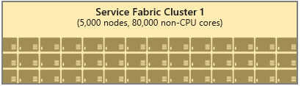
SF Mesh preview – Early Last year.
App
Model
SF resource Model
Mesh RP /Control Plane
Serverless Container Infrastructure
Service Fabric Clusters Pools
Service Fabric Cluster 1
(5000 Nodes, 80000 Cores)

Slide 19
SF Mesh preview – Second half of Last year.
Functions definition
App
Model
SF resource Model
Linux Functions Service
Mesh RP /Control Plane
Serverless Container Infrastructure
Service Fabric Cluster 1
(5000 Nodes, 80000 Cores)
Service Fabric Cluster n
(5000 Nodes, 80000 GPU Cores)

Slide 20
SF Mesh preview – End of the year
App
Model
SF resource Model
Functions definition
Linux Functions Service
Managed
CaaS primitives
container groups
networks
. . . . . .
secrets
volume
update policies
. . . . . .
auto scale
Serverless Container Platform
Service
Mesh RP /Control Plane
Service Fabric Cluster 1
(5000 Nodes, 80000 Cores)
Service Fabric Cluster n
(5000 Nodes, 80000 GPU Cores)

Slide 21
SF Mesh preview – Evolution
App
Model
OSS friendly App Package Definition
Functions definition
Evolved app model Service
Linux Functions Service
Managed
CaaS primitives
container groups
networks
. . . . . .
secrets
volume
update policies
. . . . . .
auto scale
Serverless Container Platform
Service
Mesh RP /Control Plane
Service Fabric Cluster 1
(5000 Nodes, 80000 Cores)
Service Fabric Cluster n
(5000 Nodes, 80000 GPU Cores)

Slide 22
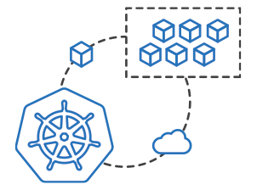
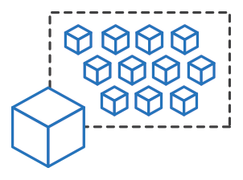
SF Mesh preview – Evolution
App
Model
OSS friendly App Package Definition
Functions definition
Future Serverless Multitenant Services
AKS
Virtual Nodes
Evolved app model Service
Linux Functions Service
ACI
Managed
CaaS primitives
container groups
networks
. . . . . .
secrets
volume
update policies
. . . . . .
auto scale
Atlas
Serverless Container Platform
Service
Atlas RP /Control Plane
Service Fabric Cluster 1
(5000 Nodes, 80000 Cores)
Service Fabric Cluster n
(5000 Nodes, 80000 GPU Cores)

Slide 23
Questions
@ryanmcintyre

